Slide 1


HVS​
Concept of High Voltage System Management

Slide 2

Contents
BMS control and diagnosis
MCU control and diagnosis
DCFC control and diagnosis
DCDC control and diagnosis
TCU control and diagnosis

Slide 3
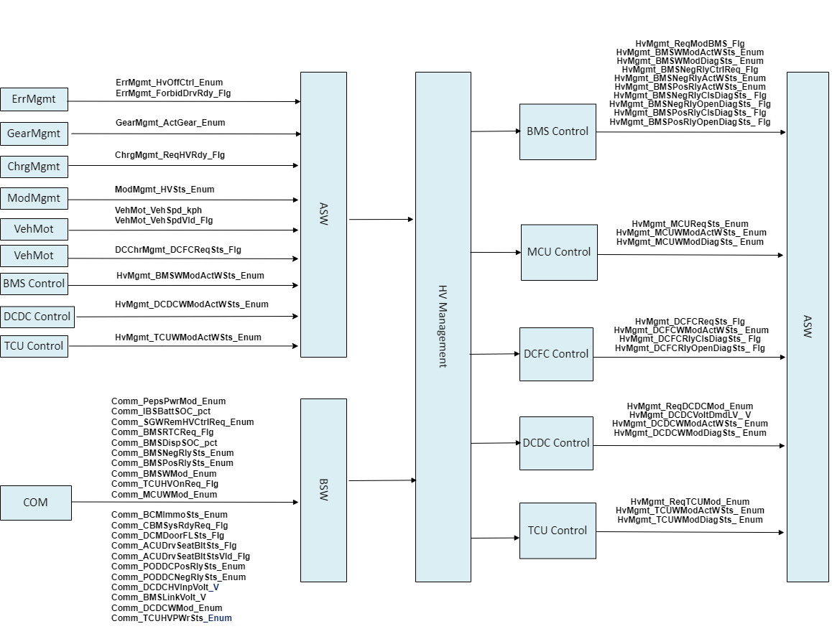
Contents

Slide 4
BMS control and diagnosis
BMS mode control and diagnosis
Functional logic description
a、BMS Active control due to HV request
b、BMS Inactive control due to HV shut down
c、Diagnosis BMS actual feedback mode according to BMS control command
BMS relay control and diagnosis
Functional logic description
a、BMS negative relay control due to Preheating
b、Diagnosis BMS negative relay actual feedback according to BMS negative relay control command
c、 Diagnosis BMS relays actual feedback according to BMS Active or Inactive control command
Interface
Input：
a、 Comm_PepsPwrMod_Enum、Comm_IBSBattSOC_pct、
Comm_SGWRemHVCtrlReq_Enum、
Comm_BMSRTCReq_Flg、Comm_BMSDispSOC_pct、
VehMot_VehSpd_kph、VehMot_VehSpdVld_Flg、
ModMgmt_HVSts_ Enum、ErrMgmt_HvOffCtrl_Enum、GearMgmt_ActGear_Enum、ChrgMgmt_ReqHVRdy_Flg
b、Comm_BMSNegRlySts_Enum、
Interface
Output:
a、 HvMgmt_ReqModBMS_ Flg、 HvMgmt_BMSWModActWSts_ Enum、HvMgmt_BMSWModDiagSts_ Enum、
HvMgmt_BMSNegRlyCtrlReq_ Flg、
HvMgmt_BMSNegRlyActWSts_ Enum、
HvMgmt_BMSPosRlyActWSts_ Enum、
HvMgmt_BMSNegRlyClsDiagSts_ Flg、
HvMgmt_BMSNegRlyOpenDiagSts_ Flg、
HvMgmt_BMSPosRlyClsDiagSts_ Flg、HvMgmt_BMSPosRlyOpenDiagSts_ Flg、

Slide 5
BMS control and diagnosis
Interface
Input：
b、 Comm_BMSPosRlySts_Enum、 Comm_BMSWMod_Enum、 HvMgmt_TCUWModActWSts_ Enum、
Comm_DCDCHVInpVolt_V、 Comm_BMSLinkVolt_V、 Comm_MCUInpVolt_V
HV ON Req
BMS Actual Inactive
Req BMS Active
BMS Inactive Feedback Succese
Error Clear
Active Feedback Succese
Active Feedback Fail or Error
Req BMS Inactive
Req BMS Inactive
HV Off Req
BMS Actual Active
Error Or Feedback Fail
BMS Inactive Feedback Fail Or
Error

Slide 6
MCU control and diagnosis
MCU mode control and diagnosis
Functional logic description
a、MCU mode control include Standby、Ready、TrqCtrl、Discharge and others
b、Diagnosis MCU actual feedback mode according to MCU control command
Interface
Input：
a、 Comm_MCUWMod_Enum、 Comm_PepsPwrMod_Enum、 Comm_BCMImmoSts_Enum、 Comm_CBMSysRdyReq_Flg、 Comm_DCMDoorFLSts_Flg、 Comm_ACUDrvSeatBltSts_Flg、
Comm_ACUDrvSeatBltStsVld_Flg 、HvMgmt_BMSWModActWSts_ Enum、 ModMgmt_HVSts_ Enum、 ErrMgmt_HvOffCtrl_Enum、ErrMgmt_ForbidDrvRdy_Flg、ChrgMgmt _ChrgSts_ Enum、 GearMgmt_ActGear_Enum
Output:
a、 HvMgmt_MCUReqSts_ Enum、 HvMgmt_MCUWModActWSts_ Enum 、HvMgmt_MCUWModDiagSts_ Enum

Slide 7
MCU control and diagnosis
Req Ready
Req Ready
Req MCU Standby
Req MCU Ready
Req MCU TrqCtrl
Req Standby
Req TrqCtrl
Req Discharge
Req Standby
MCU DisCharge

Slide 8
DCFC control and diagnosis
DCFC mode control and diagnosis
Functional logic description
a、DCFC mode control include Inactive and Active
b、Diagnosis DCFC actual feedback mode according to DCFC control command
Interface
Input：
a、 Comm_PODDCPosRlySts_Enum、 Comm_PODDCNegRlySts_Enum、 ErrMgmt_ErrLvl_Enum、 DCChrMgmt_ DCFCReqSts_ Flg
Output:
a、 HvMgmt_DCFCReqSts_ Flg、 HvMgmt_DCFCWModActWSts_ Enum、 HvMgmt_DCFCRlyClsDiagSts_ Flg、 HvMgmt_DCFCRlyOpenDiagSts_ Flg

Slide 9
DCDC control and diagnosis
DCDC mode control and diagnosis
Functional logic description
a、DCDC mode control include OFF and Buck
b、Diagnosis DCDC actual feedback mode according to DCDC control command
C、DCDC Volt control and diagnosis actual feedback
Interface
Input：
a、 Comm_DCDCHVInpVolt_V、 Comm_BMSLinkVolt_V、Comm_DCDCWMod_Enum、
Comm_DCDCVoltActLV_V 、Comm_PepsPwrMod_Enum、 Comm_IBSBattSOC_pct、Comm_SGWRemHVCtrlReq_Enum、Comm_BMSRTCReq_Flg、Comm_BMSDispSOC_pct、 ModMgmt_HVSts_ Enum、 ErrMgmt_HvOffCtrl_Enum
Output:
a、 HvMgmt_ReqDCDCMod_ Enum、 HvMgmt_DCDCVoltDmdLV_ V、 HvMgmt_DCDCWModActWSts_ Enum 、HvMgmt_DCDCWModDiagSts_ Enum、 HvMgmt_DCDCVoltLVDiagSts_ Flg

Slide 10
TCU control and diagnosis
TCU mode control and diagnosis
Functional logic description
a、TCU mode control include Enable and Disable
b、Diagnosis TCU actual feedback mode according to TCU control command
Interface
Input：
a、 Comm_TCUHVPWrSts_Enum、 HvMgmt_DCDCWModActWSts_ Enum、 ErrMgmt_HvOffCtrl_Enum
Output:
a、 HvMgmt_ReqTCUMod_ Enum、 HvMgmt_TCUWModActWSts_ Enum、 HvMgmt_TCUWModDiagSts_ Enum

Slide 11
Backup

